Slide 1

Keur-keg
Automatic Craft brewing system
Group 4
Jason Carlisle EE
Laura Hoshino EE
Kyle Rits CPE
Kevin Ruzich EE
Notes:
-Kevin

Slide 2

Motivation
Brewing beer takes time and some people lose interest in the hobby
Allows user to complete other tasks while beer is brewing which saves time
Adds consistency to recipes due to lack of human error
Easy user preparation before the start of the brew cycle
Easy operation and maintenance on the system
Notes:
-Kevin

Slide 3
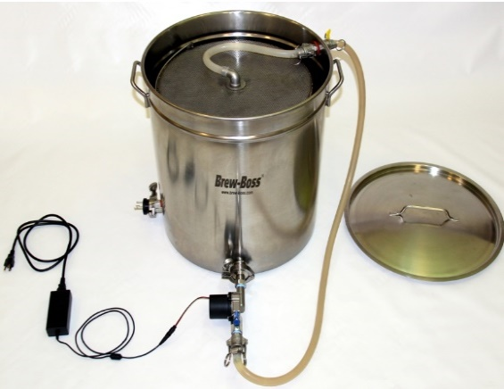
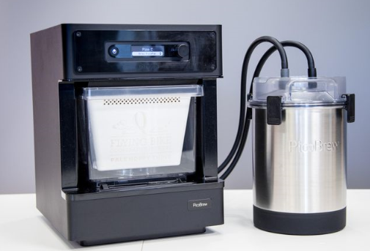
Existing Home-Brewers
The Brew Boss
  $1,600
  240 Volts
Pico Brew
  $600
  5 Liters
Keur-Keg
  120 Volts
  5 Gallons
Notes:
-Kevin

Slide 4
Brewing Process
Preparation of equipment and sanitize
Steeping and sparging (15 – 60 mins)
Boiling the mash, malt, and hops (60 – 90 mins constantly stirring)
Fermenting the wort (2 – 8+ weeks)
Bottling or kegging (3 days – 2 weeks)
* Each different recipe has different temperatures, times, and amount
Notes:
-Kevin

Slide 5
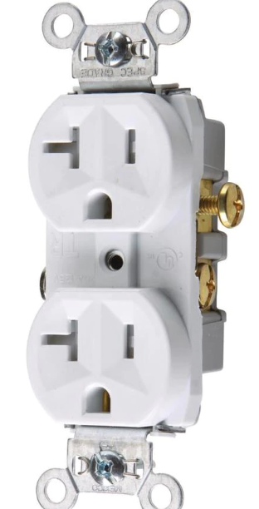
Goals and Objectives
✔ Supports multiple different recipes which brews different types of beer
✔ Make easy to sanitize components and flush the system after use
X Attempt to keep the cost to a minimum to make easily affordable
✔ Use a Standard Wall Outlet which keeps power under 2400 watts
✔ Make system user friendly and easy to operate
✔ Have the final output product yield 5 gallons
Notes:
-Kevin

Slide 6
Design Standards
Easy to remove kettles for cleaning and bottling
Flush cycle and sanitation cycle
Microcontroller reads temperatures, fluid information, and sends signals to output components
Interface to enter times, temperatures, and quantities
Support storage of multiple recipes
Temperatures and current status are displayed for the user
Updates are sent to the user via email
Notes:
-Kevin

Slide 7
Requirements and Specifications
Component | Parameter | Specification
Pots | Material | Stainless Steel
System | Size | 5 Ft³ (max)
Heating Elements | Power | 1650 Watts (max)
Hops Dispenser | Quantity | 4 Dispensers (min)
MCU Battery Power | Time | 4 Hours (min)
Input Power | Voltage | 120 VAC
Power Consumption | Power | 2000 Watts (max)
Notes:
-Kevin

Slide 8
Block Diagram
Jason
Laura
120V
Power Input
Power supply & relays
MCU
User Interface
Kyle
Kevin
Power
Controls & Feed back
Mixing Motor
Flow Meter
Filling /Steeping
Pump
Filling/Cooling Pump
Filling/Transfer
Pump
Temp Sensor
Temp Sensor
Temp Sensor
Dispenser
Refrigeration
System
Heating Element
Heating Element
Level Sensor
Level Sensor
Level Sensor
Cooling
System
Steeping Pot
Boil Pot
Fermenting Unit
Notes:
-Kevin

Slide 9
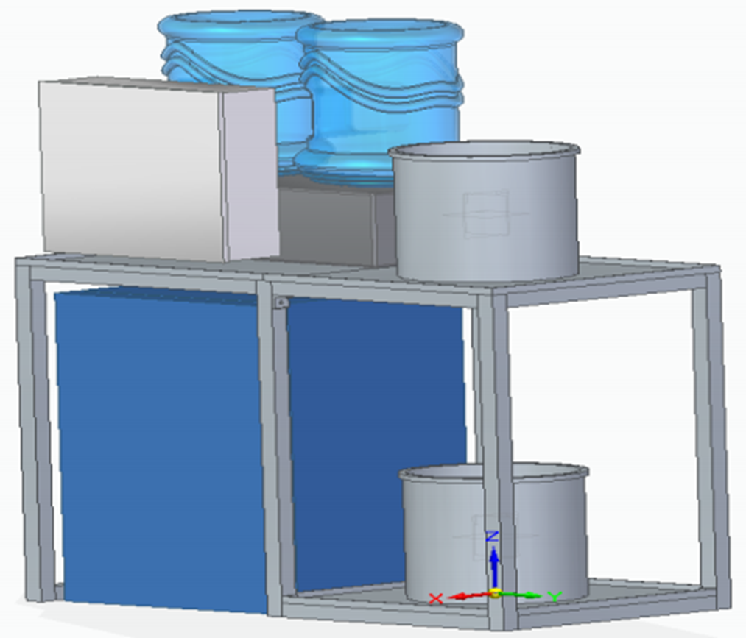
Project Design Approach
One kettle design
Two kettle design
Separate individual systems
Different hops and malt dispensing designs
Heating elements
Fermenting refrigeration
Notes:
-Kevin

Slide 10

Proposed Implementation
Fresh water system
Fluid transfer system
Food quality components
Steeping system
Boiling system
Fermenting system
Electrical control cabinet
User interface
Frame for all components
Notes:
-Kevin

Slide 11
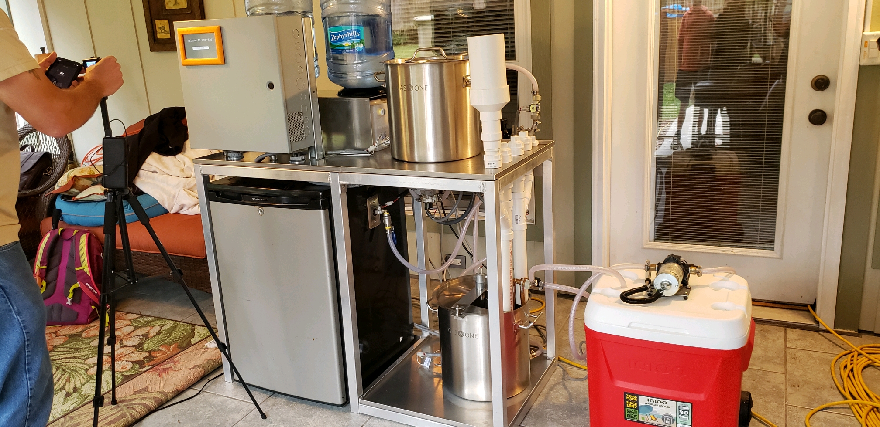
Actual Implementation
Fresh water system
Fluid transfer system
Food quality components
Steeping system
Boiling system
Fermenting system
Electrical control cabinet
User interface
Frame for all components
Notes:
-Kevin

Slide 12
Project Components
Notes:
-Jason

Slide 13
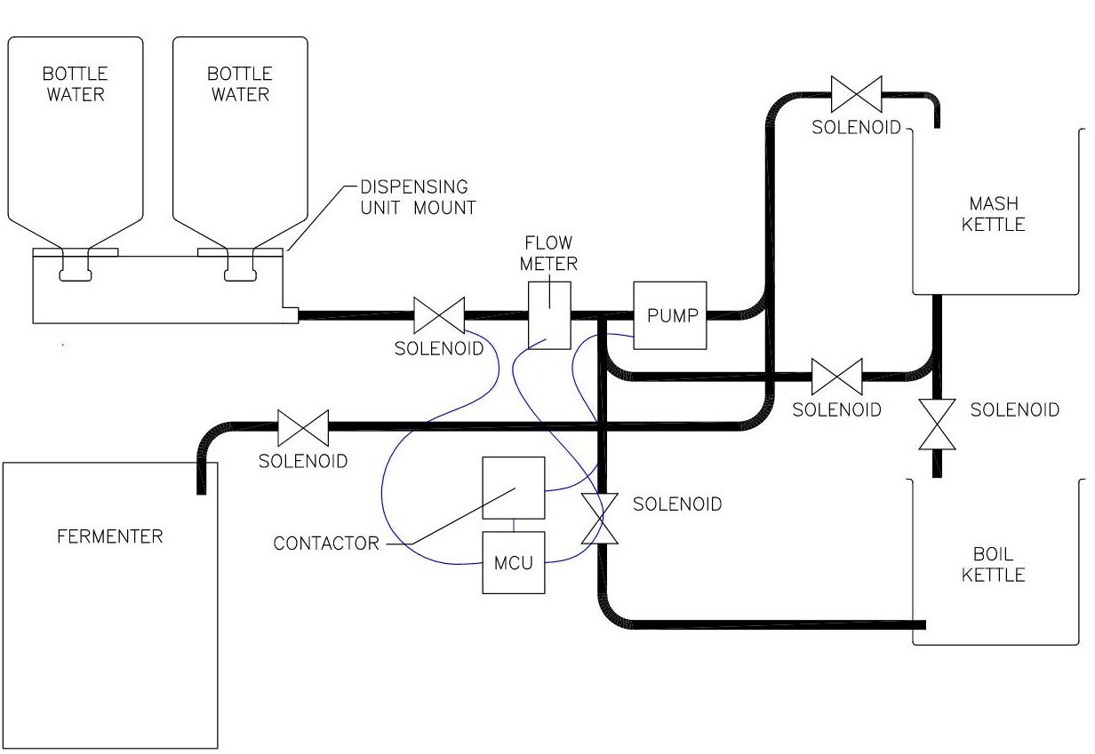
Water and Fluid Transfer System
5 gallon jugs on a mount
Water Reservoir
½” food quality hose throughout
½” connectors for the solenoids, kettles, and fermenting unit
Float switch
120 VAC pump for circulation, water input, and transfer
Notes:
-Jason

Slide 14
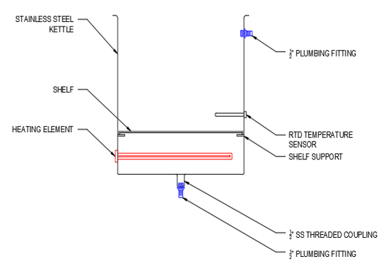
Steeping System
Steeping kettle
½” metal quick disconnects
120 VAC 1650 watt heating element
Temperature sensor
Shelf for grains
Notes:
-Jason

Slide 15
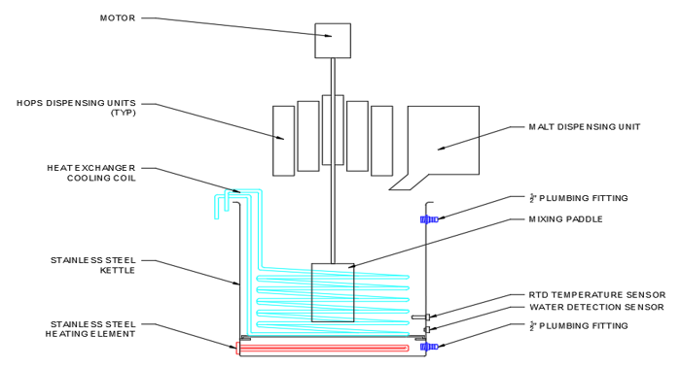
Boiling System
The boiling system consists of :
Boiling kettle
Mixing unit
Hops dispensing unit
Malt dispensing unit
Chilling unit
Notes:
-Jason

Slide 16
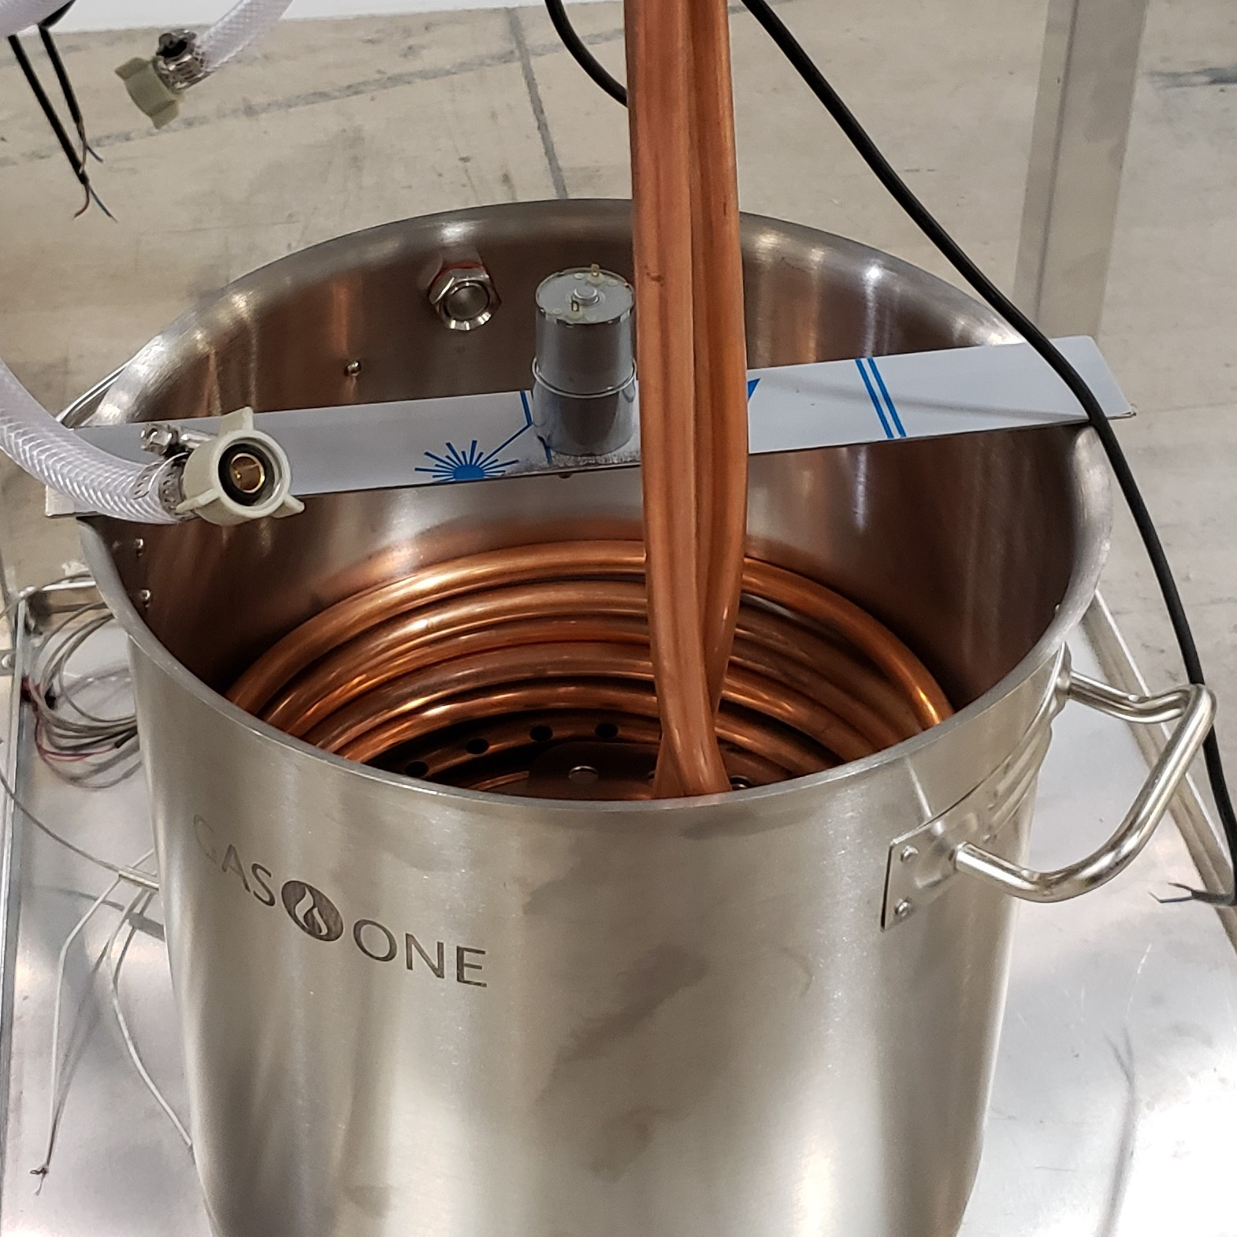
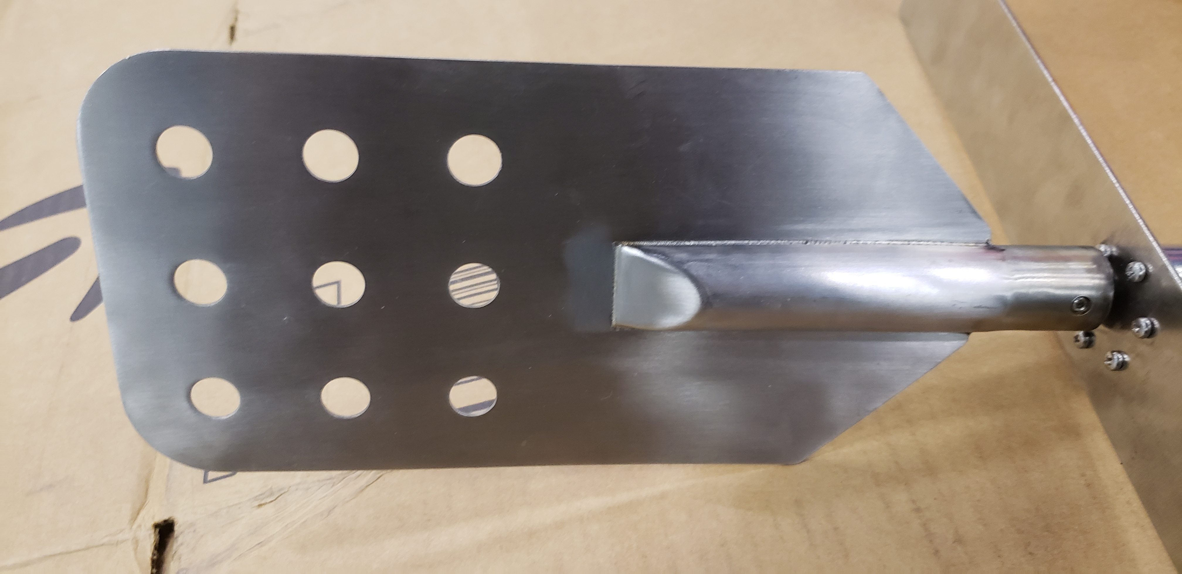
Mixing Unit
12 VDC mixing motor
50 rpm synchronous motor
Thoroughly mix and stop boil overs
Notes:
-Jason

Slide 17
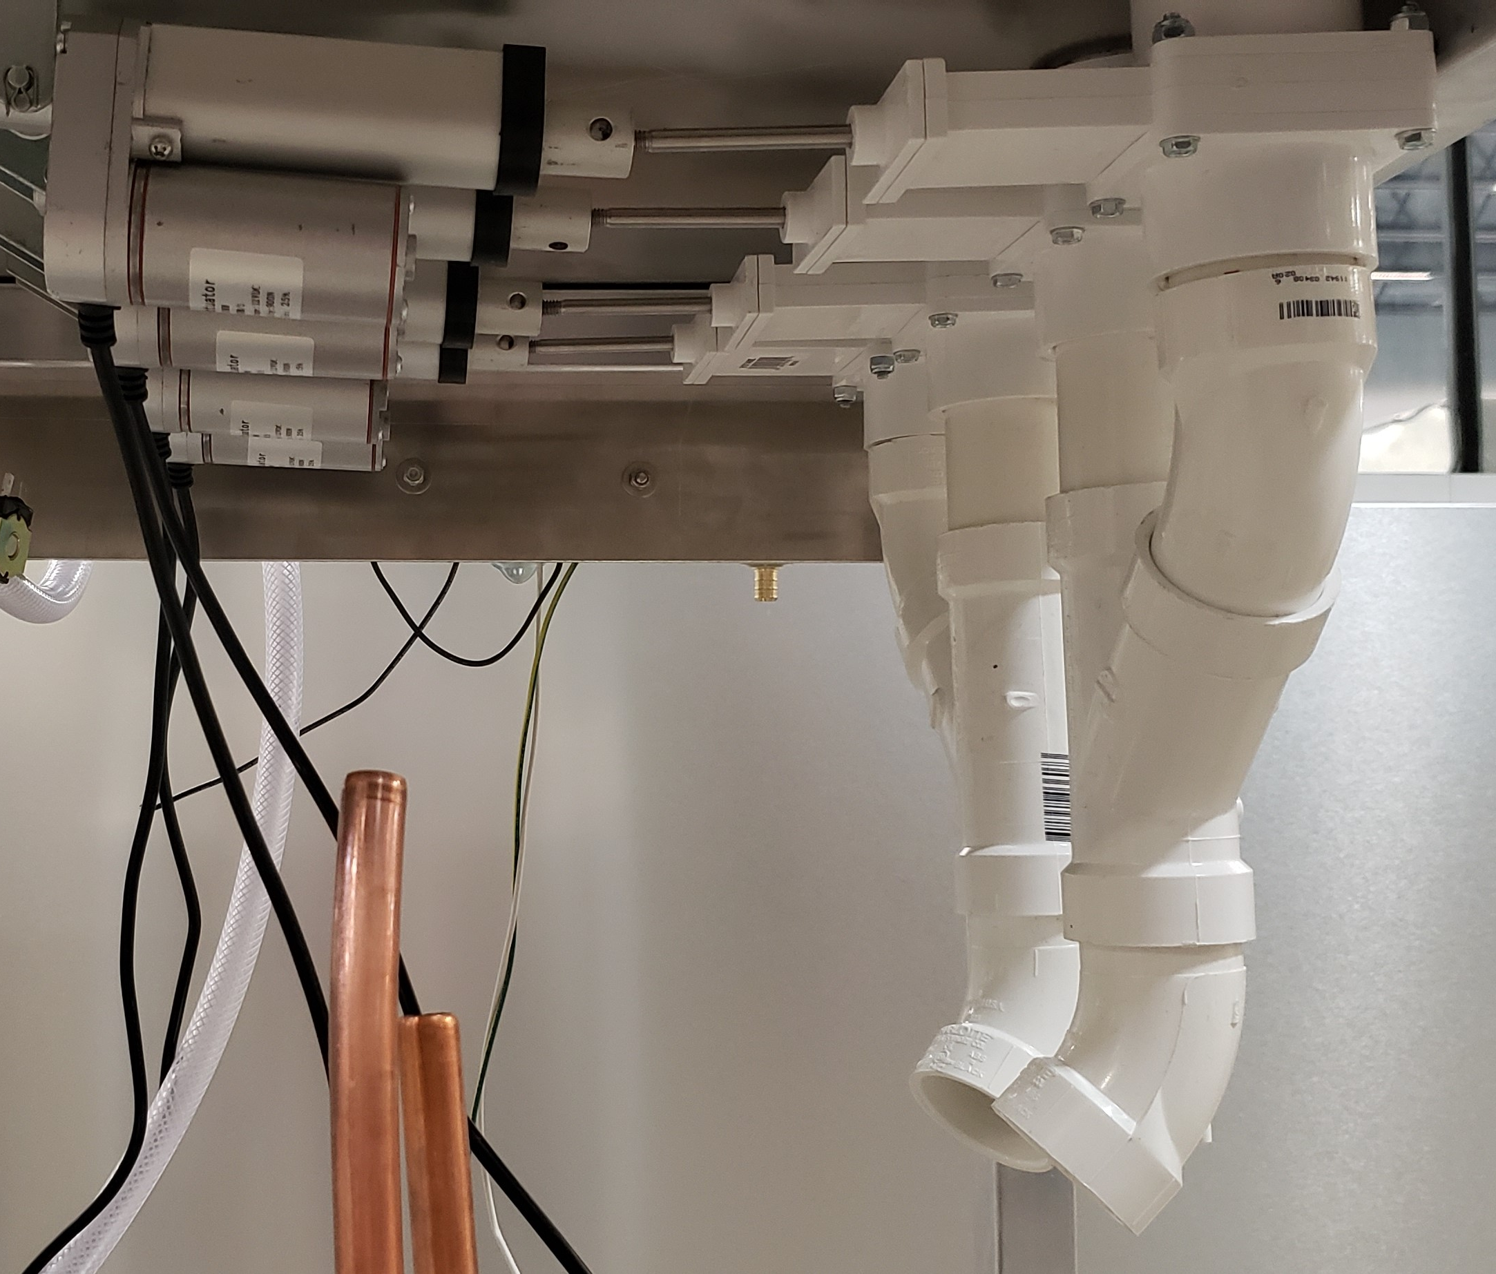
Hops Dispensing Unit
4 12 VDC linear actuators 2” stroke
4 PVC gate valves
Mounts for actuators and gate valves
PVC pipe for holding the hops
Notes:
-Jason

Slide 18
Chiller Unit
120 VAC pump
Heat exchanger cooling coil
Reservoir for ice water
Notes:
-Jason

Slide 19
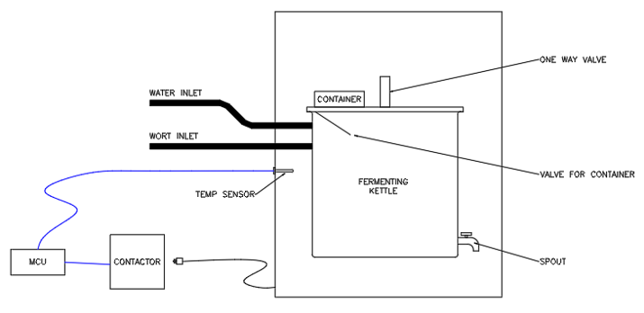
Fermenting Unit
Refrigerator
Fermenting pot
½” quick disconnects for pot
Temperature sensor
Stopper and airlock
Dispensing spigot
Tube for dispensing flavors and dry hops
Notes:
-Jason

Slide 20
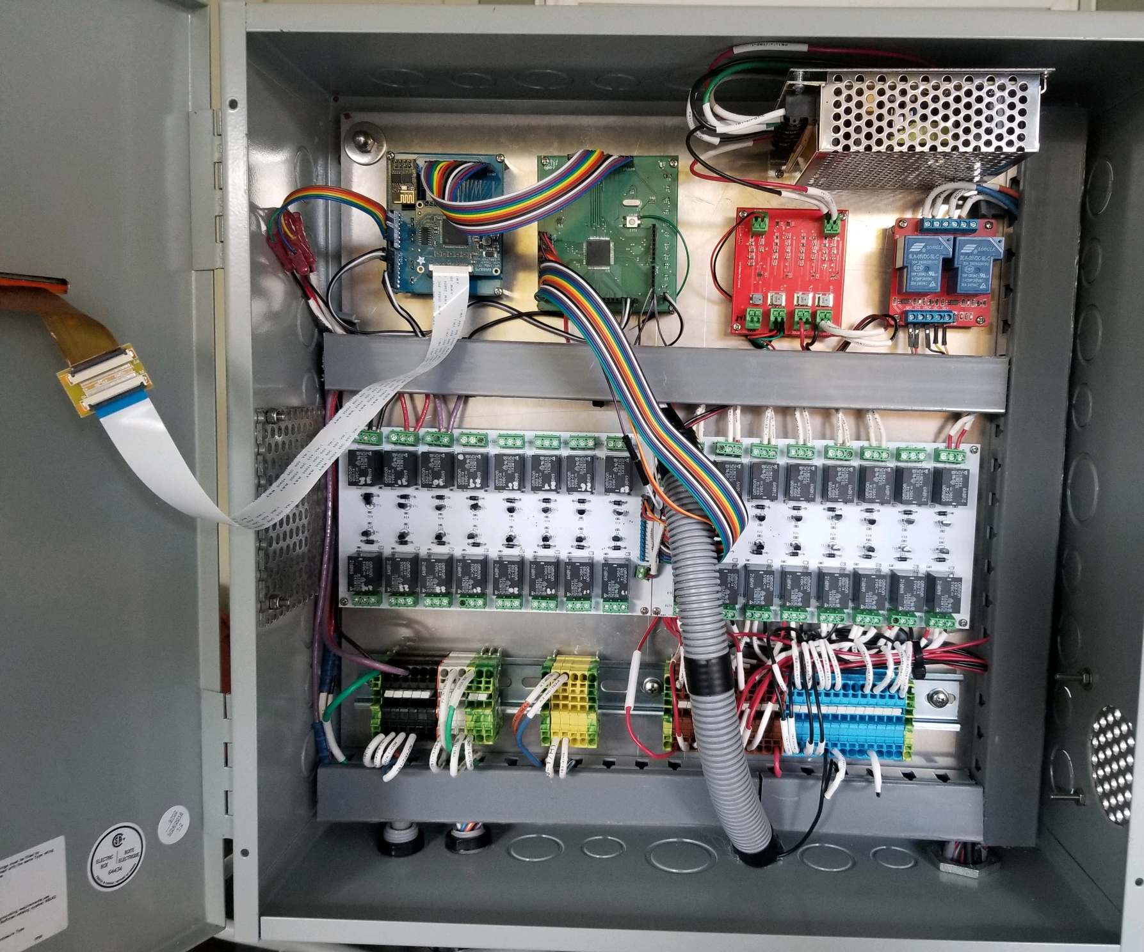
Control Cabinet
The control cabinet contains:
Relays and wiring
Power supply
Battery backup
MCU
Notes:
-Jason

Slide 21
Relays
Two 16 channel relay boards
  Linear actuators-4 , Solenoids-6,pumps, mixing motor, refrigerator
2 channel relay board
  Two heating elements
Relay Specifications
Relay | Voltage input | Supply voltage max | Coil current | Current max | MCU input signal
16 CH | 5 VDC | 250 VAC, 30 VDC | 40 mA | 10 A | High
2 CH | 5VDC | 250 VAC, 30 VDC | 85 mA | 30 A | High
Notes:
-Jason

Slide 22
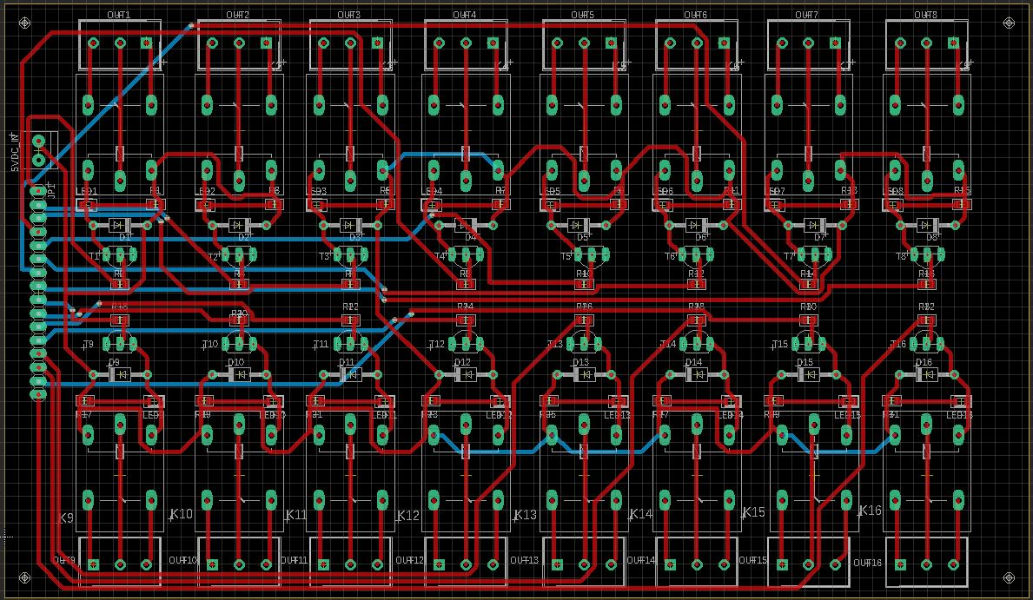
Notes:
-Jason

Slide 23
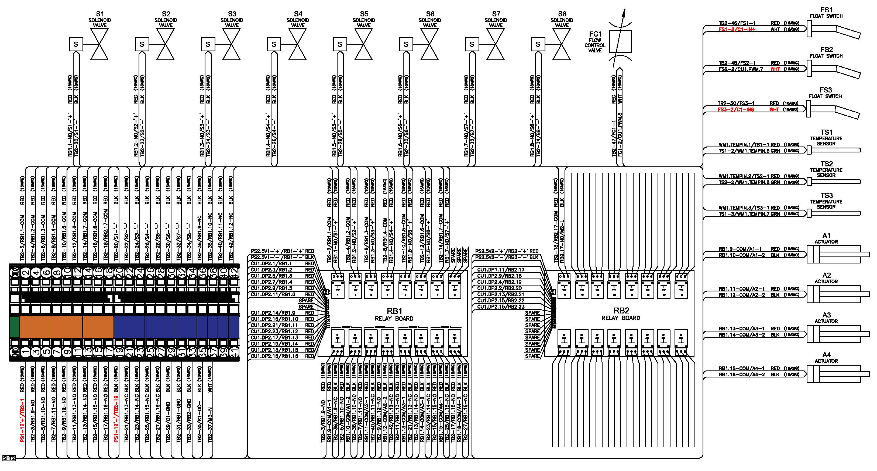
Wiring Diagram
Notes:
-Jason

Slide 24
MCU – Comparisons
 | 8051 | PIC | AVR | ARM
Bus width | 8-bit | 8/16/32-bit | 8/32-bit | 32/ 64-bit
Communication Protocols | UART, USART,SPI,I2C | PIC, UART, USART, LIN, CAN, Ethernet, SPI, I2S | UART, USART, SPI, I2C, (special purpose AVR support CAN, USB, Ethernet) | UART, USART, LIN, I2C, SPI, CAN, USB, Ethernet, I2S, DSP, SAI, IrDA
Speed | 12 Clock/instruction cycle | 4 Clock/instruction cycle | 1 clock/ instruction cycle | 1 clock/ instruction cycle
Power Consumption | Average | Low | Low | Low
Families | 8051 variants | PIC16,PIC17, PIC18, PIC24, PIC32 | Tiny, Atmega, Xmega, special purpose AVR | ARMv4,5,6,7 and series
Community | Vast | Very Good | Very Good | Vast
Cost | Very Low | Average | Average | Low
Popular Microcontrollers | AT89C51, P89v51, etc. | PIC18fXX8, PIC16f88X, PIC32MXX | Atmega8, 16, 32, Arduino Community | LPC2148, ARM Cortex-M0 to ARM Cortex-M7, etc.
Notes:
-Kyle

Slide 25
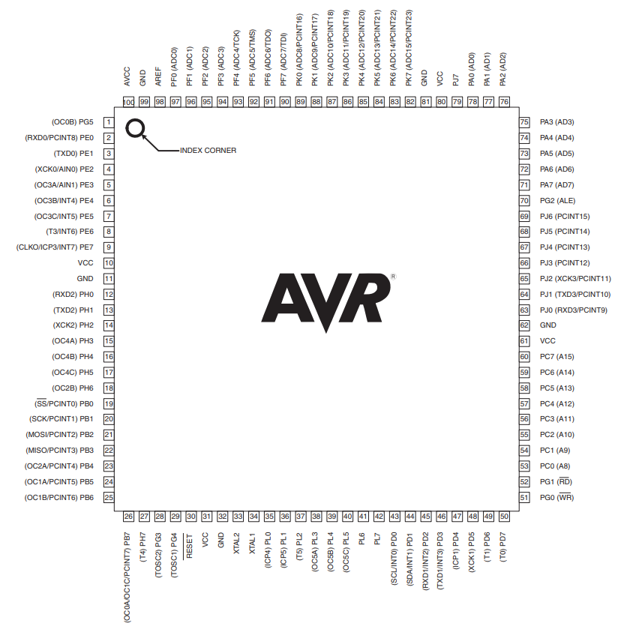
MCU – ATmega2560
54 digital IO pins
16 analog input pins
Simple power supply
Easy to use coding environment
Arduino Board for testing
Notes:
-Kyle

Slide 26
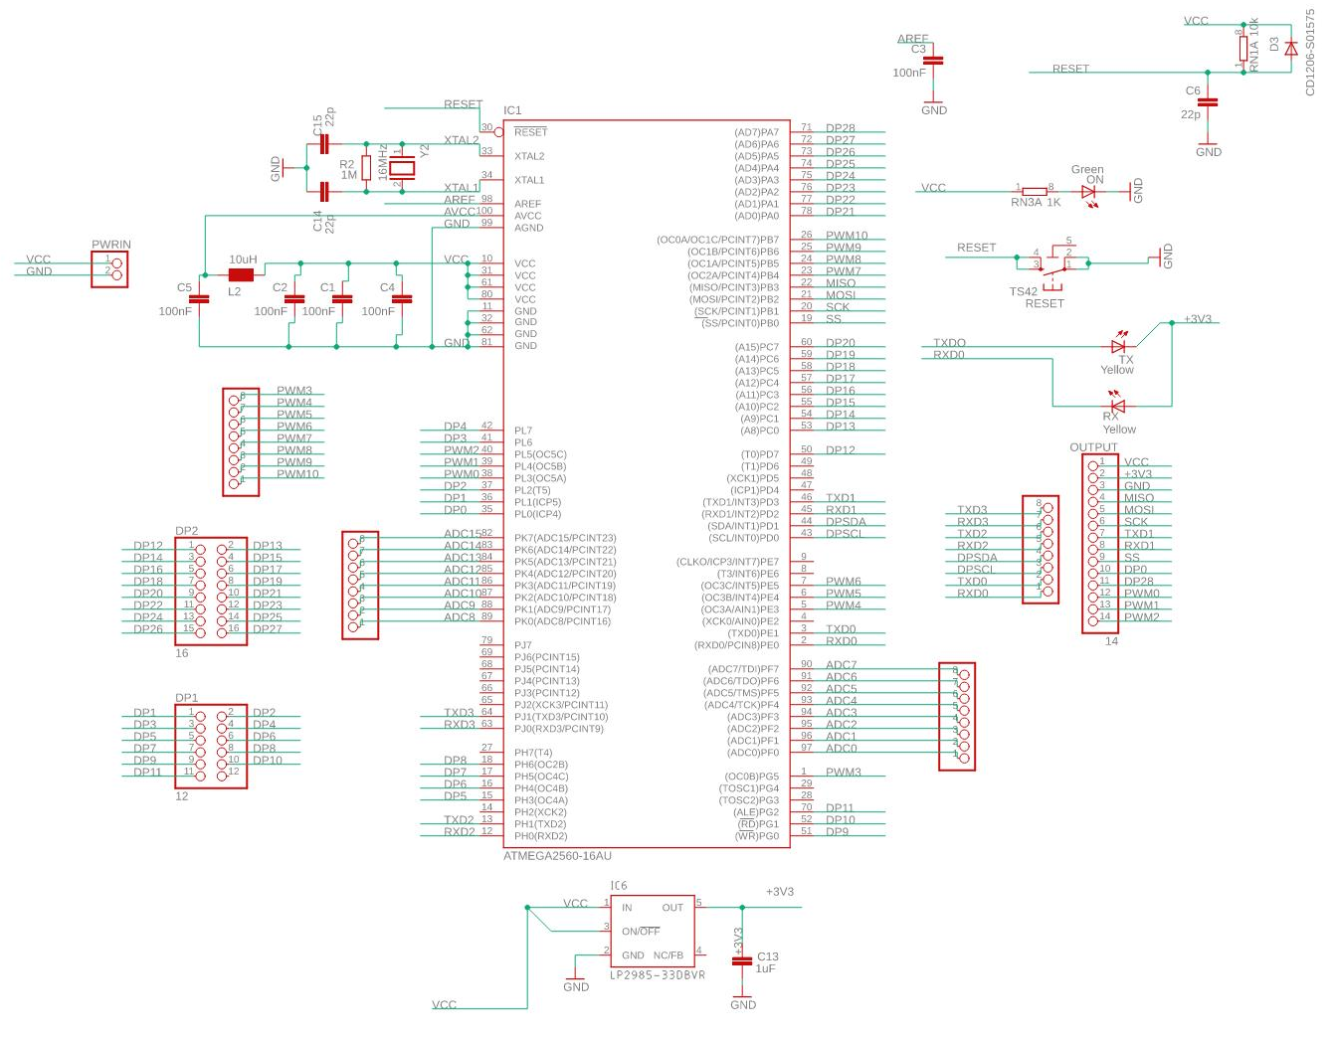
Main PCB Design
ATmega2560
3.3V Regulator
VCC and GND protection
Reset button
Power on LED
16 MHz crystal
Multiple pinouts
Notes:
-Kevin

Slide 27
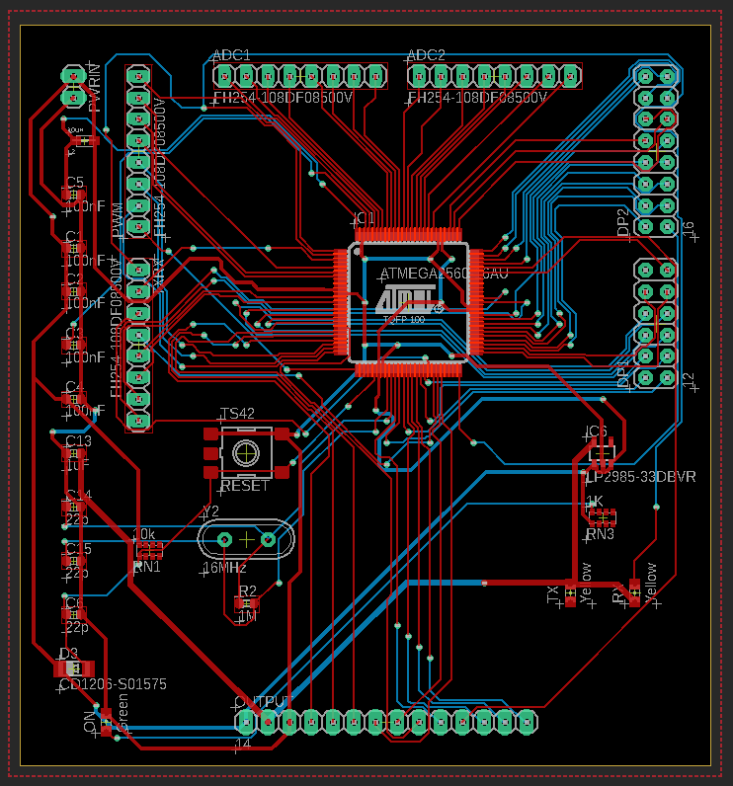
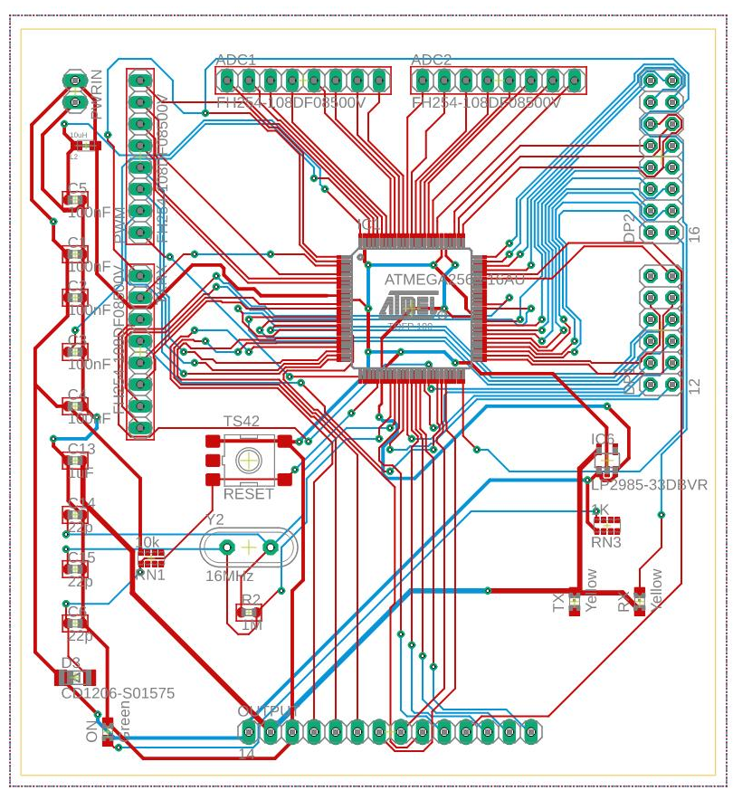
Notes:
-Kevin

Slide 28
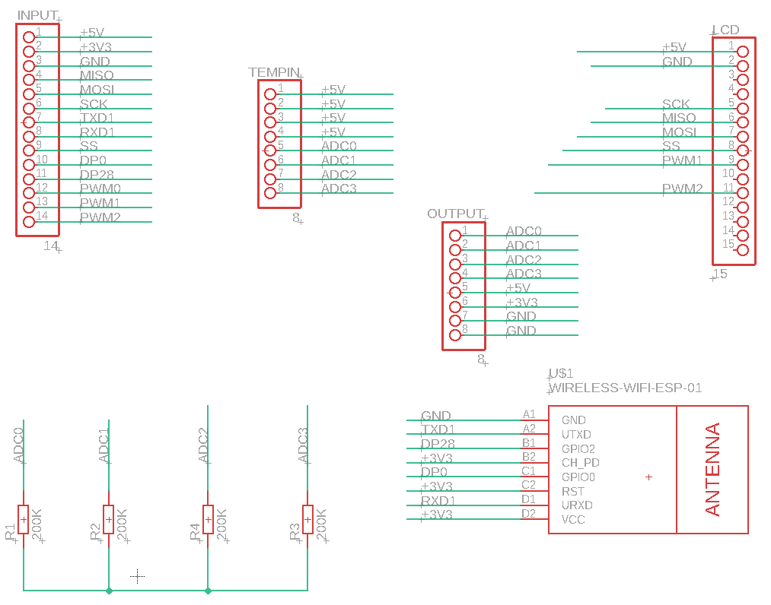
Sub PCB Design
Touch Screen Driver Board (RA8875)
WiFi Module (ESP8266 ESP-01)
Voltage Divider for temperature sensors
Notes:
-Kevin

Slide 29
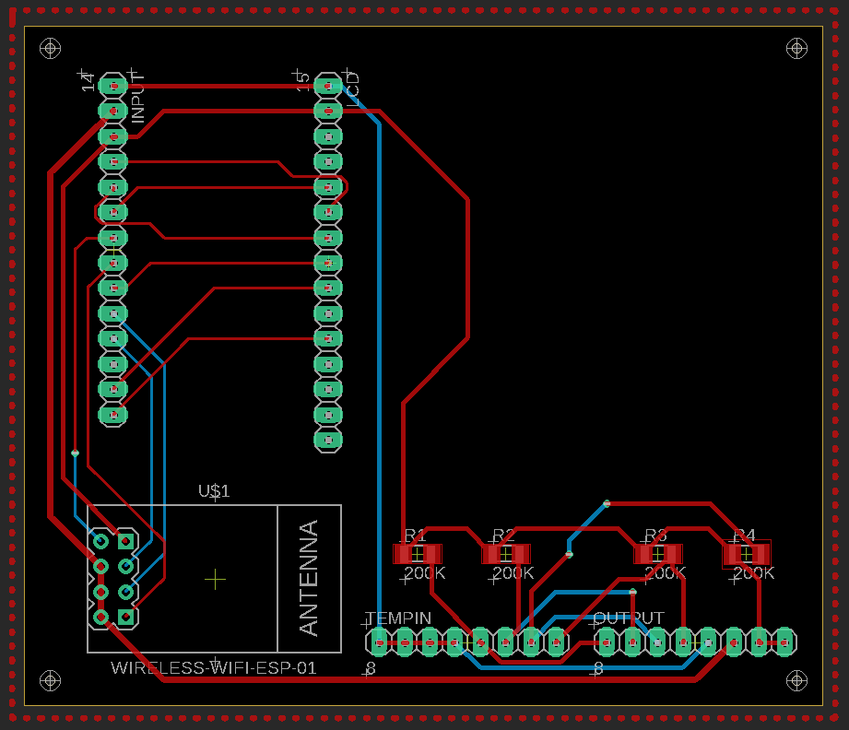
Notes:
-KEVIN!!!!

Slide 30
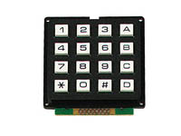
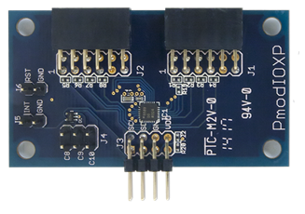
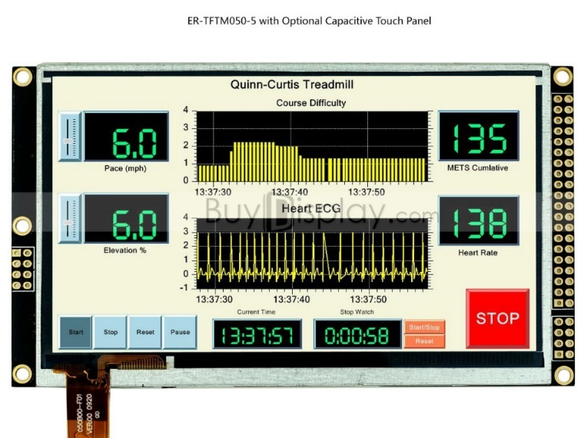
User Interface – (Input) Comparisons
Keypad
  Simple
  Cheap
Keyboard
  Requires translator
  Easier for user
Touchscreen
  Expensive
  2 for 1
  Complex
Notes:
-Kyle

Slide 31
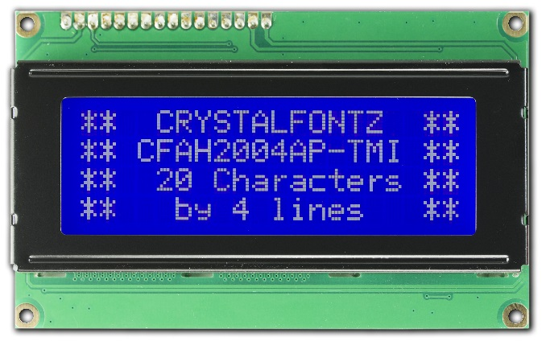
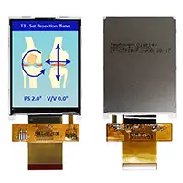
User Interface – (Output) Comparison
LCD Character Display
  Cheap
  Simple
LCD Screen
  Expensive
  Elaborate/potential
Touch screen
  LCD Screen + Input
Notes:
-Kyle

Slide 32
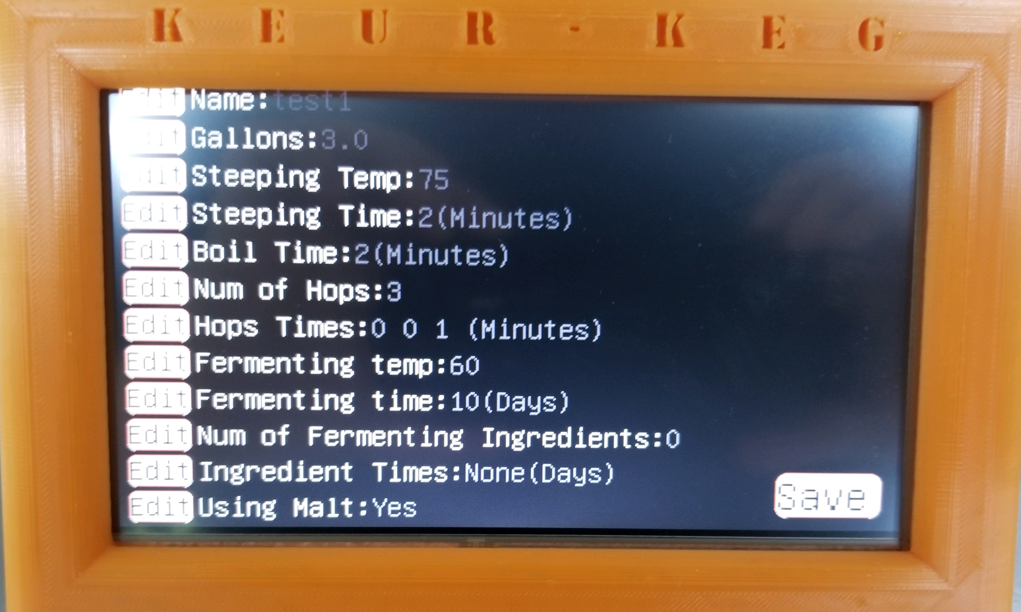
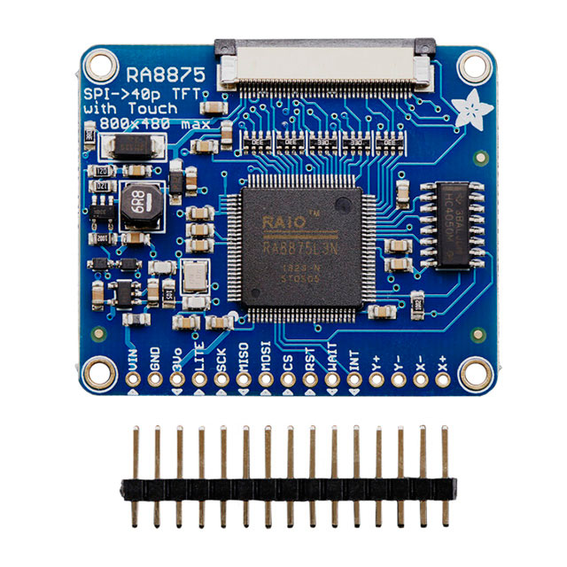
User Interface
7 Inch LCD Touch Screen
Designing through MCU is challenging
  RA8875 Driver Board solves this
  Extra cost
Touch screen is more aesthetically pleasing
  Provides endless possibilities for designs
Notes:
-Kyle

Slide 33
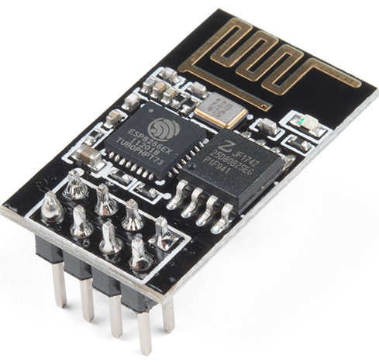
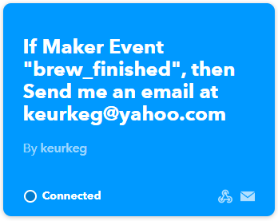
WiFi (ESP8266)
Communicate updates via email
  Design
    Permanent email address for brewer
    Code sends info to IFTTT.com
  User
    User must connect device to WiFi
    User must manage forwarding email address
Notes:
-Kyle

Slide 34
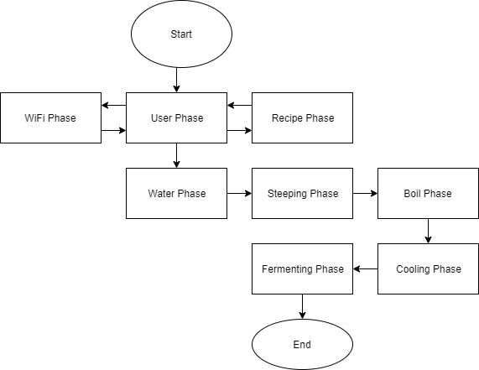
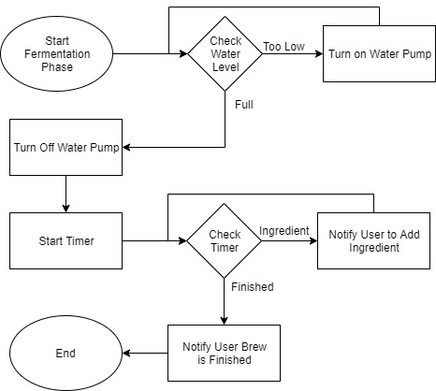
Software Engineering
Flow Charts:
Overview
Fermenting
Notes:
-Gay

Slide 35
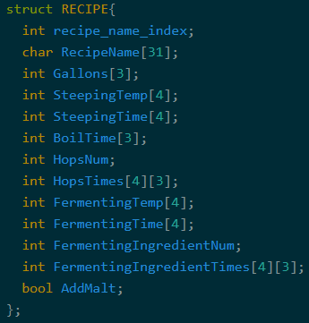
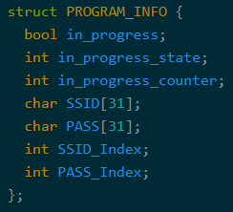
Software Engineering
Data Structures
Recipe:
Info:
Button:
Notes:
-Kyle

Slide 36
Software Engineering
Functions
  void transformCoordinates(int *x, int *y)
  void sendEmailBrewFinished()
  void printKeyBoard(int layout)
  int keyBoardTouched(int x, int y, int layout)
  void screen_in_progress(int cycle, int temp, float flow, int timer_time)
Notes:
-Kyle

Slide 37
Power Consumption
Possible Concurrent Loads
Notes:
-Laura

Slide 38
Power Distribution
9 Volt Battery Backup
Wall Outlet
Terminal Block
Power Supply
120VAC
120VAC
12 VDC
9 VDC
3.3 Volt Regulator
5 Volt Regulator
5 Volt Regulator
5 Volt Regulator
3.3VDC
5VDC
5VDC
5VDC
WiFi Module Spare
Relay Board 1
Relay Board 2
MCU
Notes:
-Laura

Slide 39
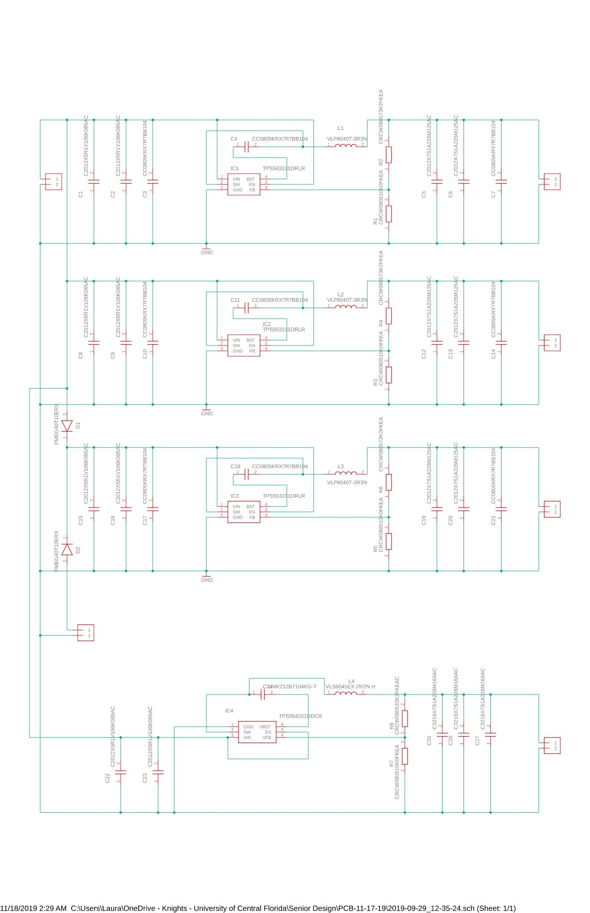
Power Supply PCB Design
12VDC
5V Regulator –TI’s TPS563231DRLR
  $0.82
  1.6mm X 1.6mm
3.3V Regulator – TI’s TPS564201DDCR
  $1.15
  1.6mm X 2.9mm
3.3VDC
5VDC
5VDC
5VDC
Notes:
-Laura

Slide 40
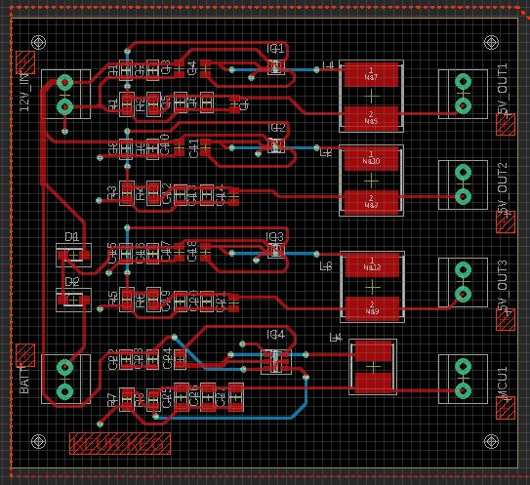
Notes:
-Laura

Slide 41
Battery Backup System
Only for MCU in the case of temporary power losses
  9 Volt battery, 500mAh
  Meets the 4 hour specification
  Protection against power flickering
9VDC
12VDC
Notes:
-Laura

Slide 42
Administrative
Notes:
-Laura

Slide 43
Proposed Project Budget
Description | Quanity | Price
Heating element | 2 | 200.00
Power supply components | 1 | 100.00
PCB | 1 | 100.00
Motor | 1 | 50.00
Pumps | 3 | 200.00
Stainless steel containers | 2 | 200.00
Hoses and components | 1 | 50.00
Cooling unit | 1 | 50.00
Sanitation materials | 1 | 50.00
Brewing material (Hops, malt) | 2 | 100.00
Total | 1100.00
Notes:
-Laura

Slide 44
Actual Project Budget
Description | Quanity | Price
Water system | 1 | 180.00
Fluid transfer system | 1 | 350.00
Steeping system | 1 | 250.00
Boiling system ( Including dispensing units ) | 1 | 500.00
Fermenting system | 1 | 200.00
Control cabinet | 1 | 100.00
Relays, amplifiers, and wires | 1 | 120.00
Power supplies | 1 | 100.00
PCB/MCU | 1 | 100.00
Frame and brewing material (Hops, malt) | 1 | 100.00
Miscellaneous | ? | 500.00
Total | 2500.00
Notes:
-Laura

Slide 45
Roles and Responsibilities
Name | Fluid Systems | Steeping System | Boiling Systems | Fermenting System | PCB/MCU | Power Supplies | Comm. and Coding | Frame and Control
Jason | X | X | X |  |  |  |  | X
Kyle |  |  | X |  | X |  | X
Laura |  |  | X |  |  | X |  | X
Kevin | X |  | X | X | X |  | X
Notes:
-Laura

Slide 46
Testing
Notes:
-Laura

Slide 47
Testing
Test | Outcome
Max Current of System | 14 A
Memory Storage of Recipes | 25 Recipes
Email | Sent and Received
WiFi | Connects
User interface | Reads input and displays properly
Functions | Communicate and run properly
Temperature Control | ±5 F
Flow Control | ±2%
Power Supply | Tested to full load
PCB Test | All input and outputs full function
Pumps | Proper flow
Float Switch | Properly operate
Relay Boards | Proper switching
Notes:
-Laura

Slide 48
Issues and Lesson Learned
MCU kept resetting
Condensation on electronics
Reaching boiling temperature and temperature readings
SPI communication with RA8875 and MAX31865 board
Email protocol refused communication
Notes:
-Everyone

Slide 49

Questions?

